Slide 1
Threshold Based Segmentation Method to Calculate COVID-19 Infection Rate
Azrin Khan

Slide 2
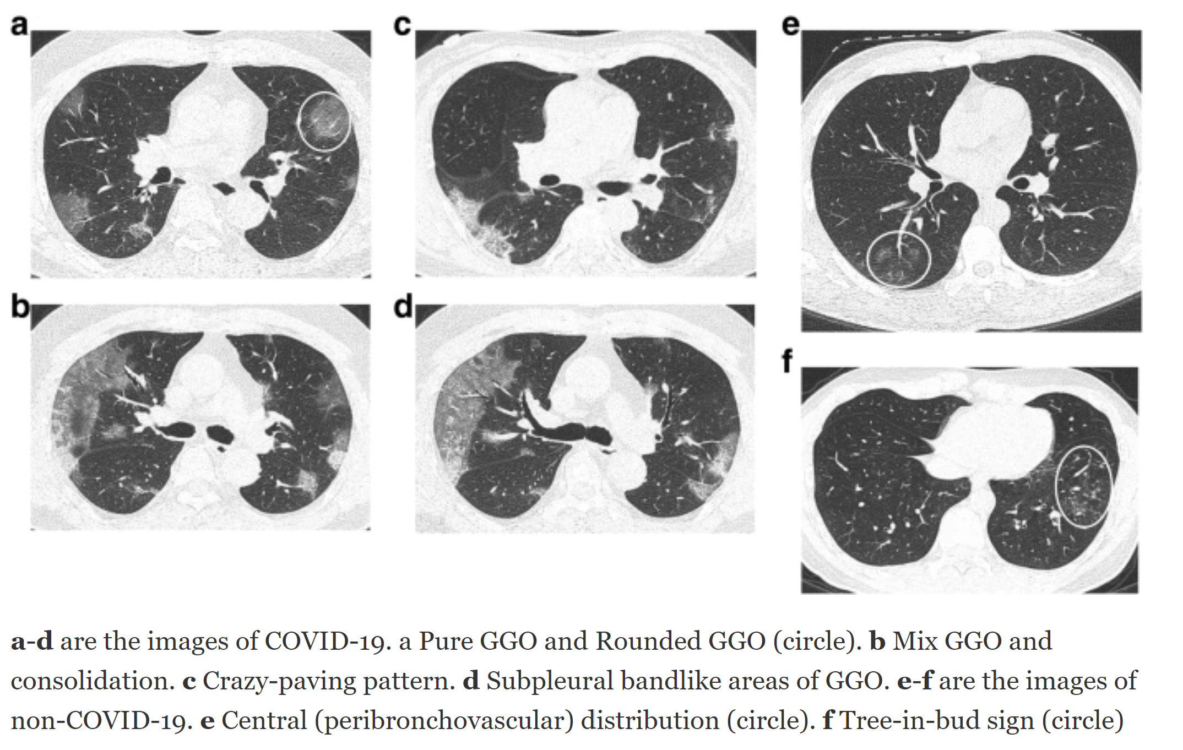
CT Scans & Segmentations
Provides detailed pictures of lung features effective in diagnosing COVID-19
Extraction of infected regions
Size & position of infected regions may relate to COVID-19
Luo, L., Luo, Z., Jia, Y., Zhou, C., He, J., Lyu, J., & Shen, X. (2020). CT differential diagnosis of COVID-19 and non-COVID-19 in symptomatic suspects: a practical scoring method. BMC Pulmonary Medicine, 20, 1-9.
Notes:
Further explanations of CT features will be discussed later.

Slide 3
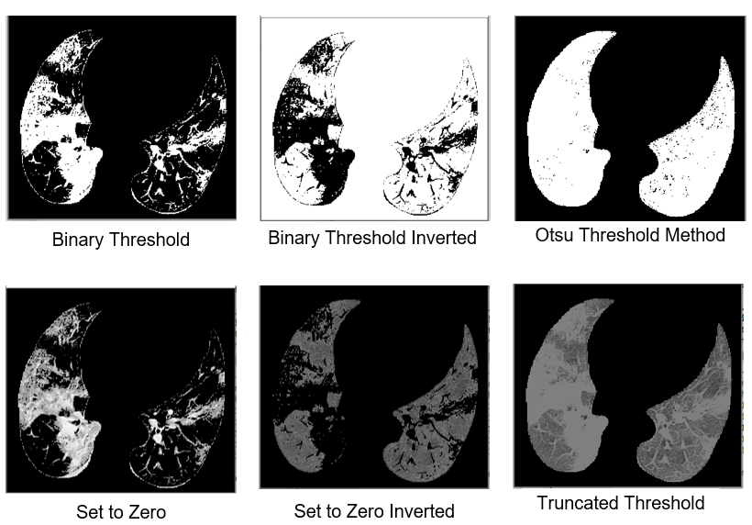
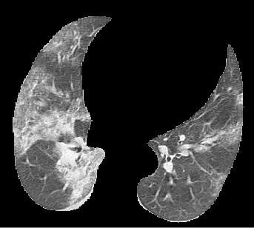
Image thresholding on lung mask
Python OpenCV
Lung Mask
Analyzing threshold types

Slide 4
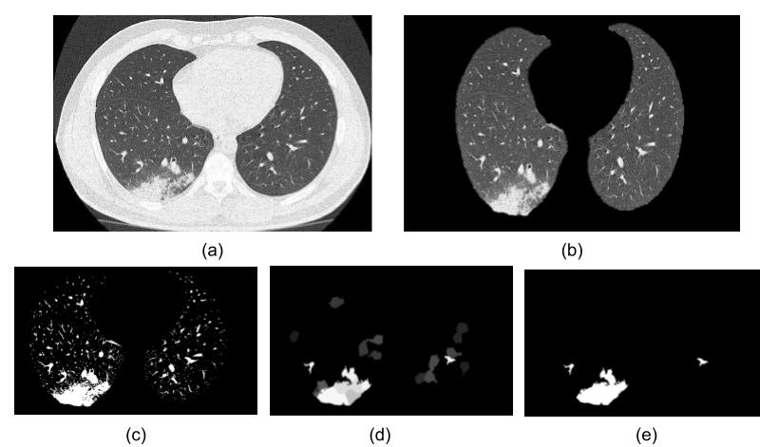
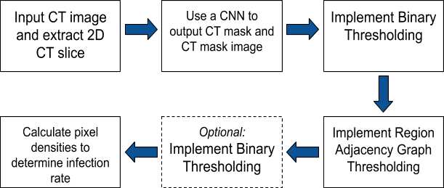
Method
Table 1. Diagram of our proposed method to calculate infection rate using pixel densities of infected area segmentation.
Figure 2. Images representing steps of the method: (a) CT slice, (b) the 2D mask of the CT, (c) implemented binary thresholding, (d) implemented region adjacency graph thresholding, and (e) implemented binary thresholding again, which can be used to compute the white pixel density (segmentation) to compare with the total mask pixel density.
(site 2, site 6)

Slide 5
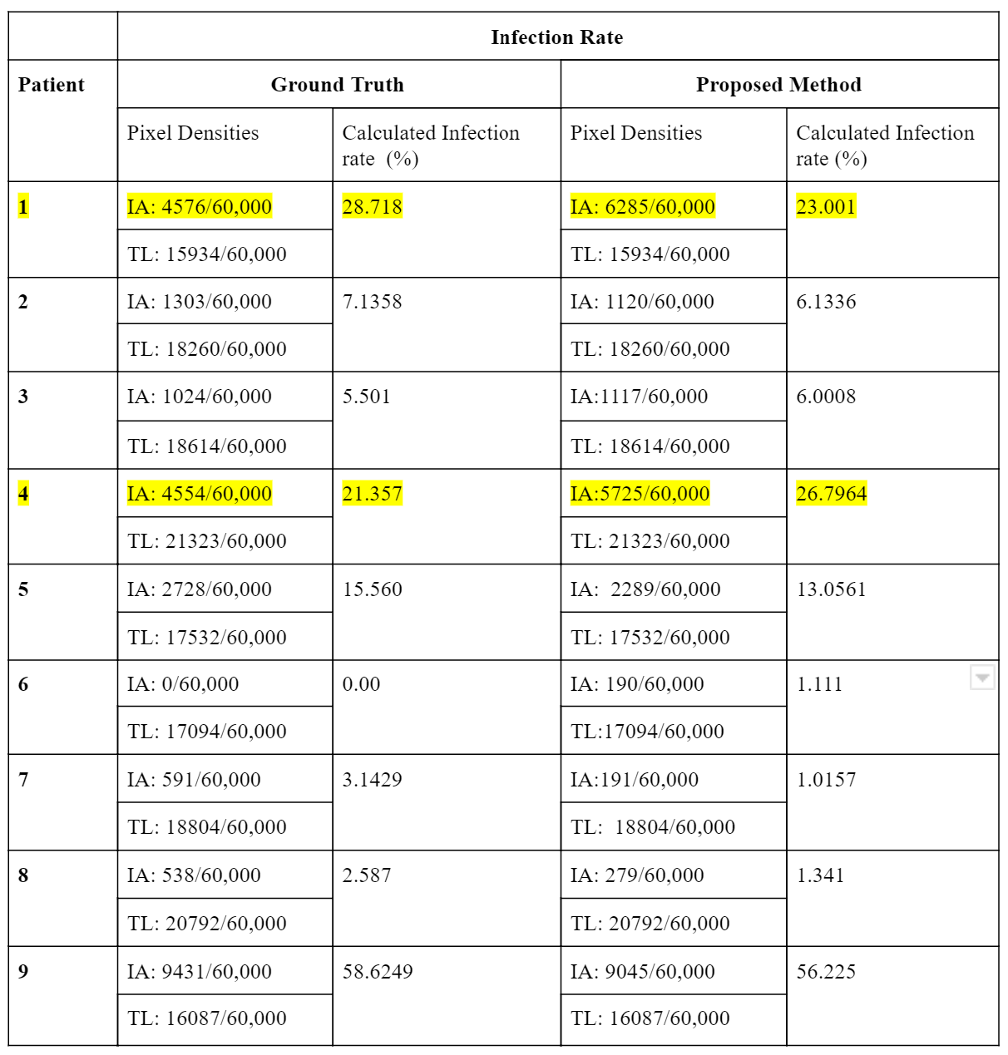
Validation of method
Proposed method calculated infection rates were within ±2% precision of the ground truth values.
Few outliers with wrongly processed lungs masks
Table 2. Comparing calculated infected rates of ground truth and proposed method. Pixel densities for the infected area (IF) and total lung (TL) are calculated to find infection rate.

Slide 6
Future Development & Interests
Further validate method
Medical image segmentation is an important image processing step.
Previous experience with image analysis

